Slide 1

Capital Area Food Bank
Mid Project Report
DataDigestion

Slide 2




Meet the Team!
Natalie Wolfe
Mechanical Engineering
Ben Lin
Computer Science
Aaron Kurtz
Finance
Sapna Bagalkotkar
Computer Science
DataDigestion

Slide 3






Roadmap
Tasks
Analysis
Next Steps
Client & Problem
Data Sources
Insights

Slide 4
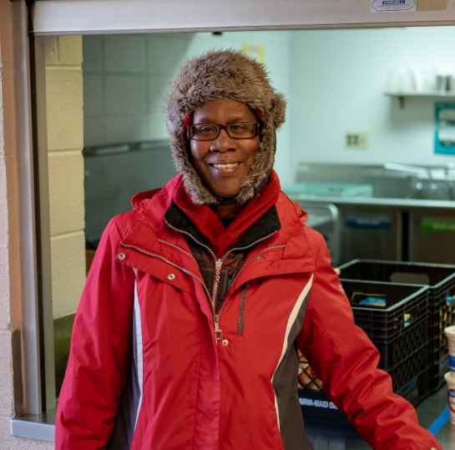
Meet Wanda

Slide 5

Meet the Client!
380,000
individuals across the DMV continuously served
Goal: break the cycle of poverty for these individuals
Point of Contact: Jake Erlich
Opportunity
Tasks
Data
Hypotheses
Current Progress
Next Steps
Notes:
380,000 constituents served

Slide 6
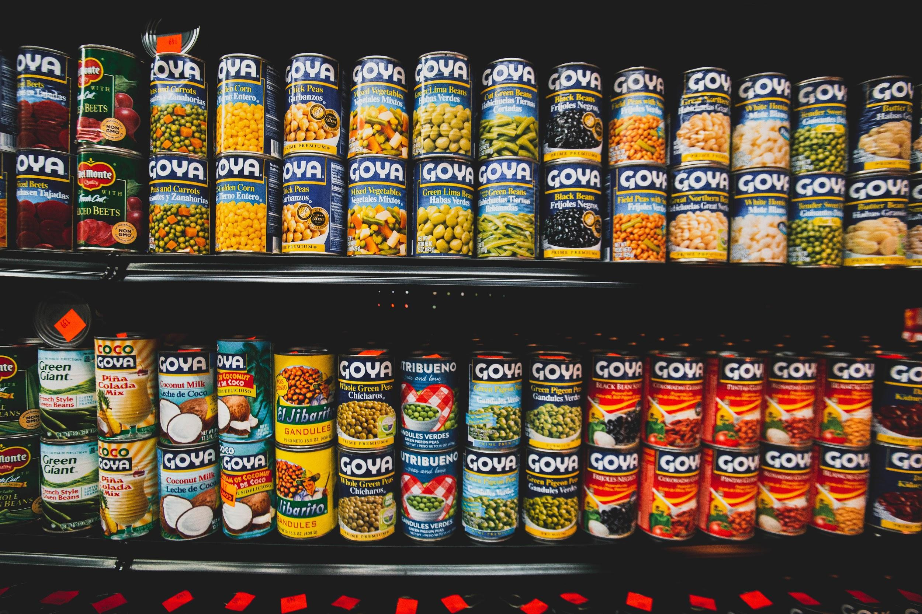
Problem
Food insecure communities are being pushed out of neighborhoods due to gentrification.
These communities are deprived of access to health services because of food insecurity.
CAFB wants to optimize their impact in the most opportunistic neighborhoods.

Slide 7
Tasks

Slide 8



Tasks & Data Plan
Find opportunities for CAFB expansion in identified federal opportunity zones.
Expand CAFB partnerships with healthcare facilities in DC, MD, and VA.
Predict density shifts in food insecurity due to gentrification of DMV neighborhoods.
Opportunity
Tasks
Data
Hypotheses
Current Progress
Next Steps
Notes:
Opportunity zone - an economically distressed community private investments, under certain conditions, may be eligible for capital gain tax incentives.
by incentivizing long- term investments in low-income neighborhoods.

Slide 9
Data Sources & Plan

Slide 10
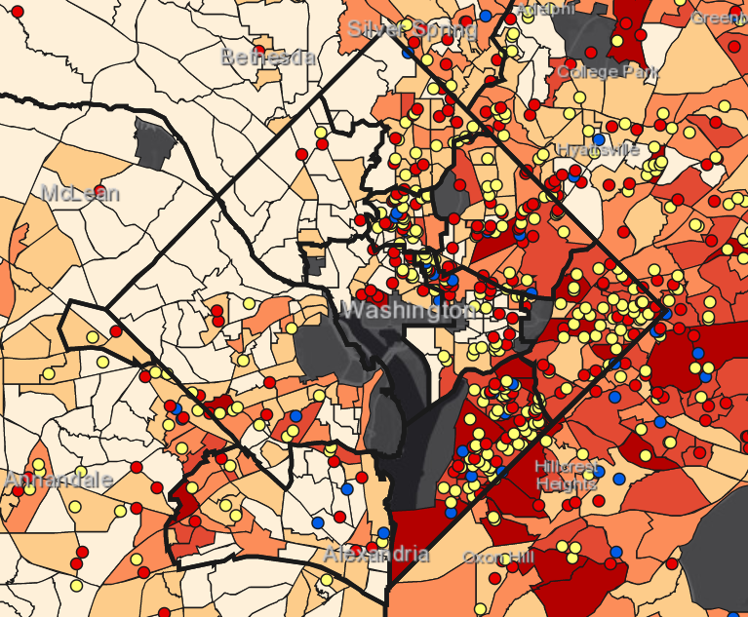
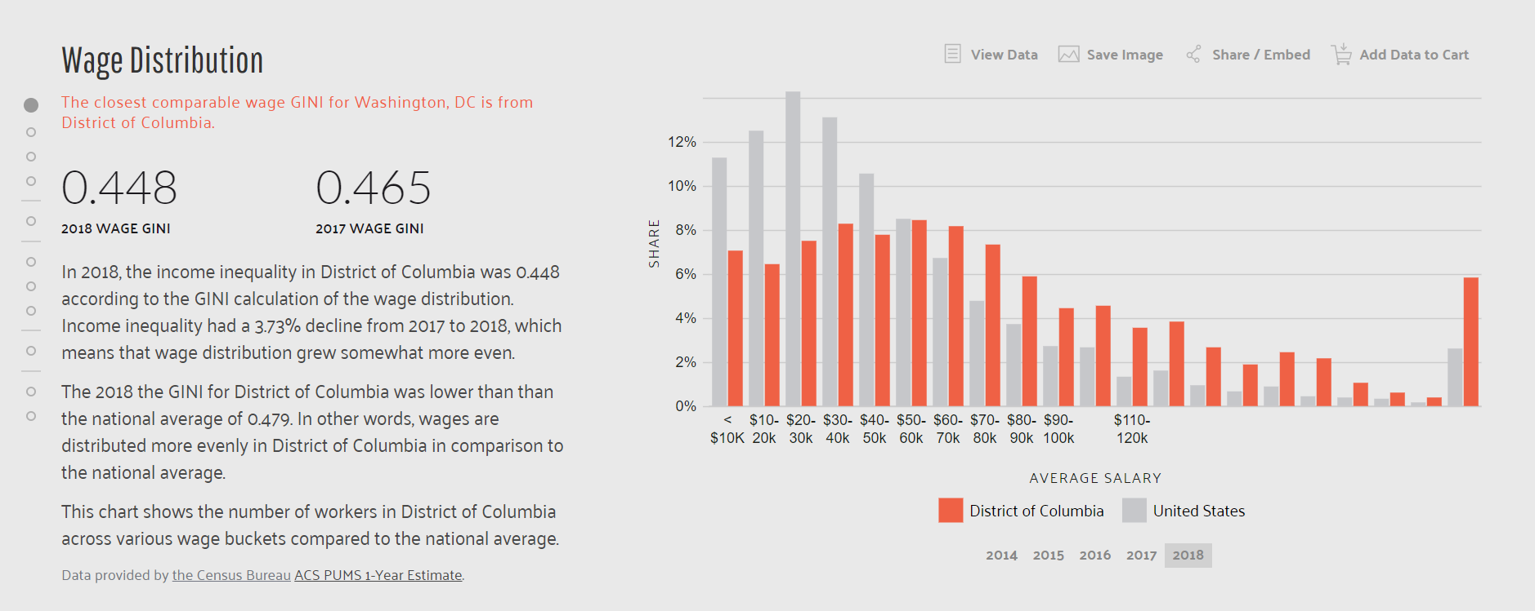
Data Sources
The census data we have right now is the recently released (in January) 2013-2018 ACS data. Pulled from here.
https://data.census.gov/cedsci/
https://datausa.io/profile/geo/washington-dc/
https://healthdata.gov/
Hunger Heat Map
ArcGIS software
Two CSV files
CAFB Distribution Locations
Census Socioeconomic Data
https://healthdata.gov/
Opportunity
Tasks
Data
Hypotheses
Current Progress
Next Steps

Slide 11
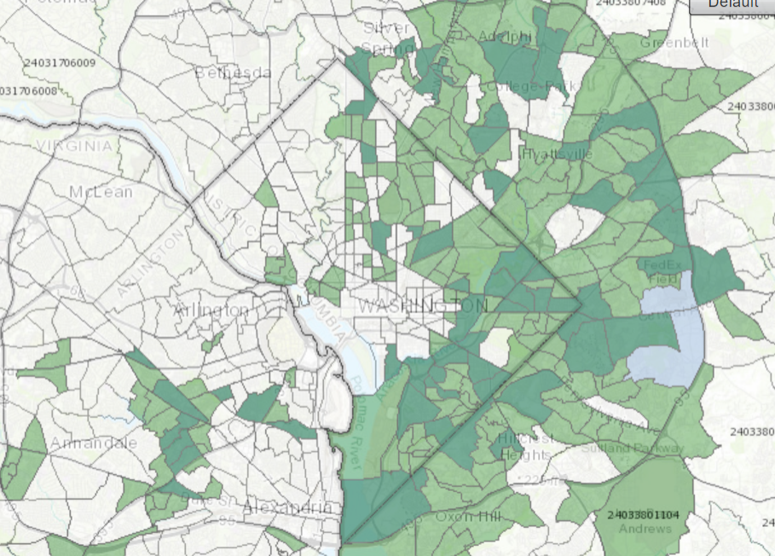
Data Sources
The census data we have right now is the recently released (in January) 2013-2018 ACS data. Pulled from here.
https://data.census.gov/cedsci/
https://datausa.io/profile/geo/washington-dc/
https://healthdata.gov/
Federal Opportunity Zone Data
25 federal opportunity zones
Areas that are eligible for financial gain, government encouraging development and growth
CSV files publicly available
https://healthdata.gov/
Opportunity
Tasks
Data
Hypotheses
Current Progress
Next Steps

Slide 12
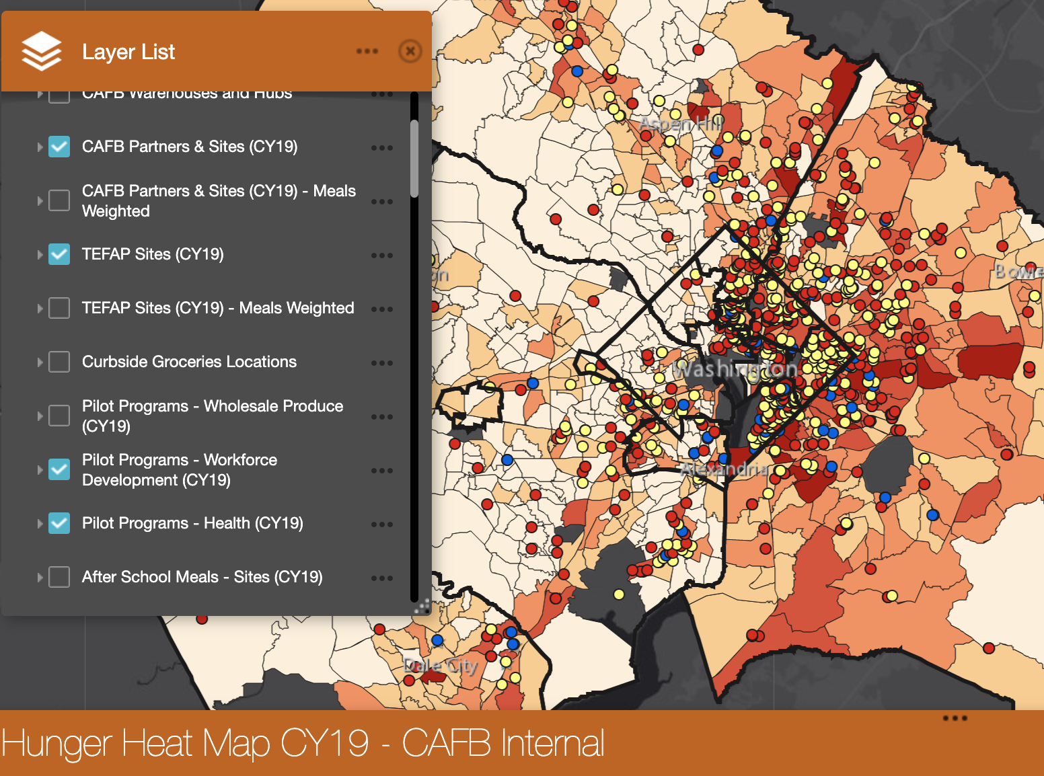
Graphical Representation of Data
HHM overlays, folium maps with new possible locations plotted on overlay
Representations of how many people use CAFB food banks based on the places that are visited most often
Opportunity
Tasks
Data
Hypotheses
Current Progress
Next Steps
Notes:
PROGRESS

Slide 13
Hypotheses

Slide 14

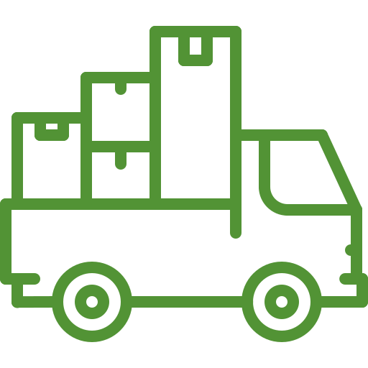
Hypotheses
Populations with large amounts of low income individuals are generally less concentrated around areas with large amounts of health centers (primary care, clinics, hospitals, etc).
Gentrification of Washington DC is pushing low-income people out of the city district and into other areas. (Downtown-DC → Prince George’s County)
Opportunity
Tasks
Data
Hypotheses
Current Progress
Next Steps

Slide 15
Current Progress

Slide 16
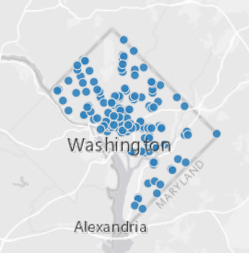
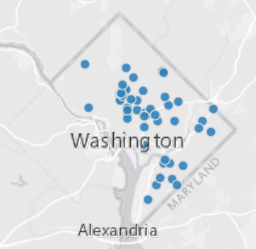
Current Progress
The census data we have right now is the recently released (in January) 2013-2018 ACS data. Pulled from here.
https://data.census.gov/cedsci/
https://datausa.io/profile/geo/washington-dc/
https://healthdata.gov/
D.C. Healthcare Data
Obtained through Open Data D.C.
CSVs of pharmacy/primary care name, address, and coordinates
https://healthdata.gov/
Primary Healthcare Centers
Pharmacies
Opportunity
Tasks
Data
Hypotheses
Current Progress
Next Steps

Slide 17
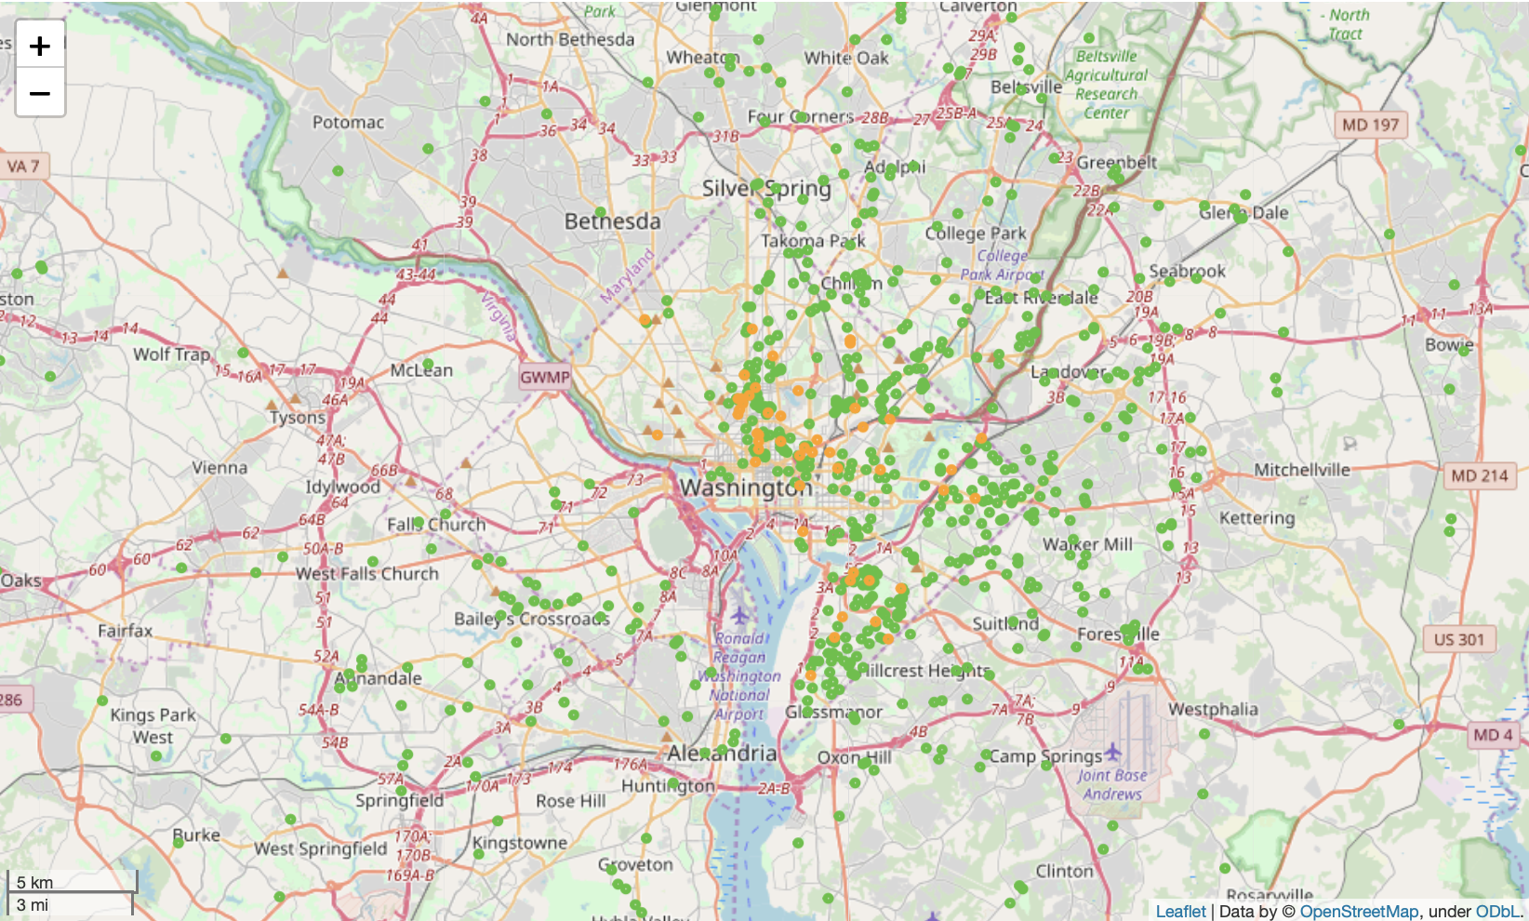
Current Progress
folium
python package
Visualize geodata
Load multiple datasets on to one map
Combining data given and what was researched
CAFB Distribution Centers
Primary Care Centers

Slide 18
Next Steps

Slide 19
Next Steps
Opportunity Zones: Healthcare Partnerships
Gentrification and Migration
Obtain census data from multiple years to observe population shifts
Look into real estate data to predict migrations
Generate statistical significance of movements tracked
Adding layers to the HHM to explore variables that may impact the “formula” for future centers
Combine analyses from FOZ, healthcare, distance, income, and census data to find new healthcare partnerships
Opportunity
Tasks
Data
Hypotheses
Current Progress
Next Steps
Notes:
Look at distances/relationships between healthcare locations and CAFB locations
Income data
WE NEED methodology present for the first step of the project - predicting migration patterns
For FOZ and healthcare data, can say that we are looking at distance data and the income data associated with the socioeconomic census data on the HHM - use a combo of these three things to try and target places that would be good to put CAFB locations - a LOT of data combination

Slide 20
Wanda
Now
Notes:
By doing extensive research and bringing together a wide collection of data that can aid the CAFB create this sort of formula to identify the most opportunistic zones for expansion, we can continue to help people like Wanda, end the cycle of poverty in their own lives and have easy access to these basic necessities in life that they do not have now.

Slide 21
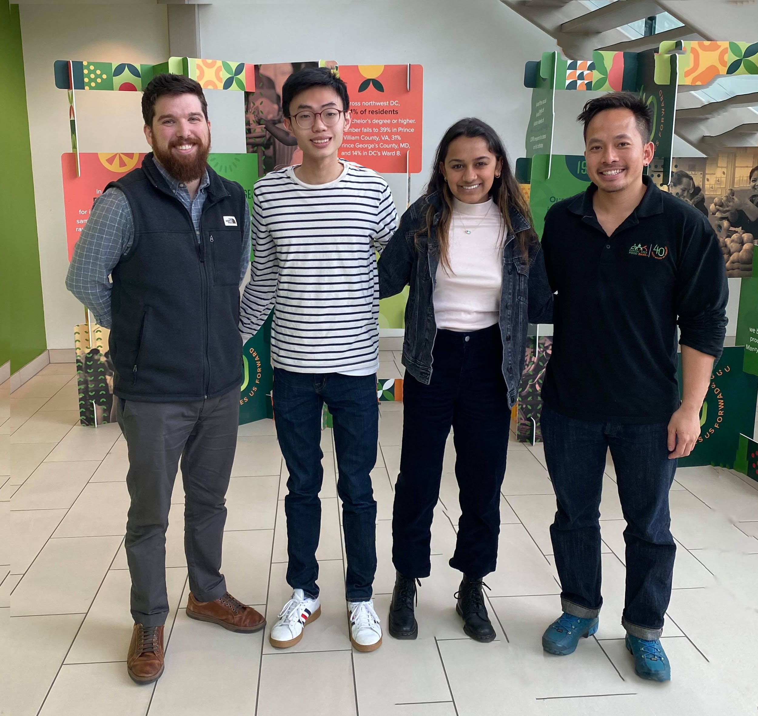
Thank You! Any questions?
Notes:
CAFB logo colors:
Dark green: 529335
0D9F04
Light green: 97ba78
Orange: f7921e
Dark Blue3: 073763

